Slide 1
Mechanism and Effect Size in Human-Microbiome Association Studies
Anthony Fodor
Bioinformatics and Genomics
UNC Charlotte

Slide 2
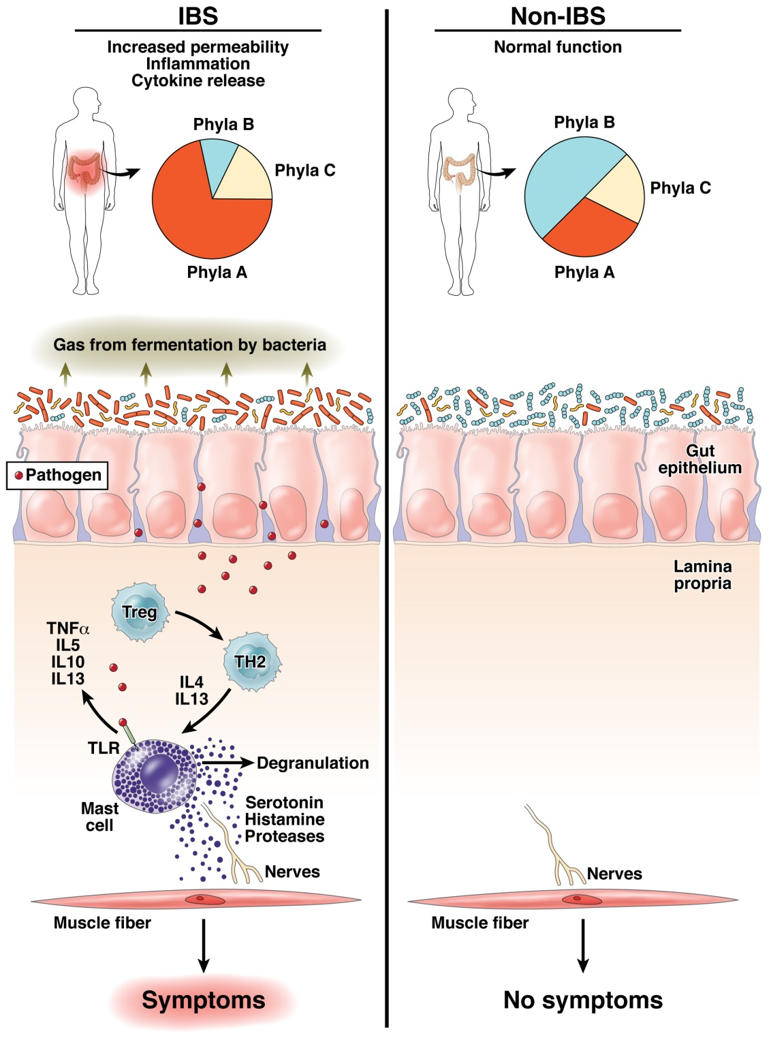
The “dysbiosis” hypothesis linking risk for inflammation related diseases to the microbiome
Fodor & Talley. Gastroenterology. 2011

Slide 3
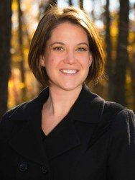

Some microbes, but not others, can cause inflammation to progress to cancer…
IL10 is an anti-inflammatory
cytokine
Gnotobiotic IL10-/- mice
Mono-associated with
E. Coli or E. faecalis
Exposed to carcinogen AOM
Janelle Arthur, UNC
Christian Jobin, UFL
Arthur et al, Science, 2012

Slide 4
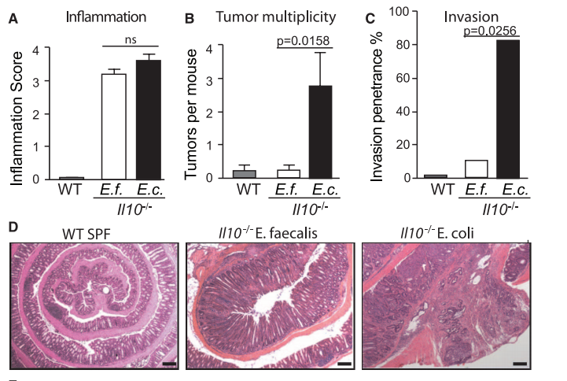
Some microbes, but not others, can cause inflammation to progress to cancer…
IL10 is an anti-inflammatory
cytokine
Gnotobiotic IL10-/- mice
Mono-associated with
E. Coli or E. faecalis
Exposed to carcinogen AOM
Janelle Arthur, UNC
Christian Jobin, UFL
Arthur et al, Science, 2012

Slide 5
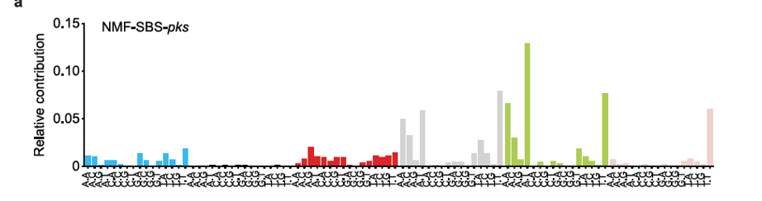

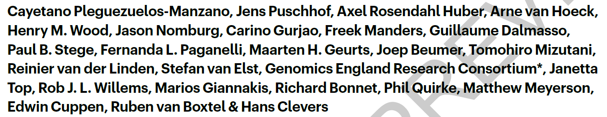
We have increasing detail on the chain of causality
Interferes with
selection against
Inflammation
E. coli/pks
The damage pks-E. Coli
does to DNA can be
directly measaured and
quantified
“Invade” the gut
during stress/birth
Stresses host cells
Proteobacteria in
the external enviroment
Cancer
Approximately 5% of all CRCs have a mutational spectrum signature
consistent with E. Coli/pks damage

Slide 6
It is not always straight-forward to elucidate mechanism

Slide 7
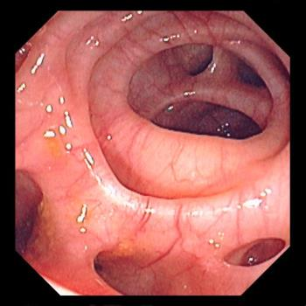

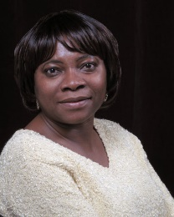
Roshonda Barner Jones
University of Southern California
Biopsies from 226 case and 309 control obtained via
colonoscopy
Temitope Keku
UNC Chapel Hill
Image: https://www.merckmanuals.com/-/media/manual/professional/images/diverticulosis_high.jpg?la=en&thn=0&mw=350
An Aberrant Microbiota is not Strongly Associated with Incidental Colonic Diverticulosis Roshonda B. Jones, Anthony A. Fodor, Anne F. Peery, Matthew C. B. Tsilimigras, Kathryn Winglee, Amber McCoy,Michael Sioda ,Robert S. Sandler, Temitope O. Keku. Scientific Reports. 2018.
Notes:
A colonic diverticulum is a saclike pouch of colonic mucosa and submucosa that protrudes through the muscular layer of the colon

Slide 8
Roshonda Barner Jones
University of Southern California
Biopsies from 226 case and 309 control obtained via
colonoscopy
Temitope Keku
UNC Chapel Hill
Microbial DNA extracted – PCR targeting the 16S rRNA gene
Image: https://www.merckmanuals.com/-/media/manual/professional/images/diverticulosis_high.jpg?la=en&thn=0&mw=350
An Aberrant Microbiota is not Strongly Associated with Incidental Colonic Diverticulosis Roshonda B. Jones, Anthony A. Fodor, Anne F. Peery, Matthew C. B. Tsilimigras, Kathryn Winglee, Amber McCoy,Michael Sioda ,Robert S. Sandler, Temitope O. Keku. Scientific Reports. 2018.
Notes:
A colonic diverticulum is a saclike pouch of colonic mucosa and submucosa that protrudes through the muscular layer of the colon

Slide 9
Roshonda Barner Jones
University of Southern California
Biopsies from 226 case and 309 control obtained via
colonoscopy
Temitope Keku
UNC Chapel Hill
Microbial DNA extracted – PCR targeting the 16S rRNA gene
Sequences generated via Illumina sequencing.
Classified into a counts table
Image: https://www.merckmanuals.com/-/media/manual/professional/images/diverticulosis_high.jpg?la=en&thn=0&mw=350
An Aberrant Microbiota is not Strongly Associated with Incidental Colonic Diverticulosis Roshonda B. Jones, Anthony A. Fodor, Anne F. Peery, Matthew C. B. Tsilimigras, Kathryn Winglee, Amber McCoy,Michael Sioda ,Robert S. Sandler, Temitope O. Keku. Scientific Reports. 2018.
Notes:
A colonic diverticulum is a saclike pouch of colonic mucosa and submucosa that protrudes through the muscular layer of the colon

Slide 10
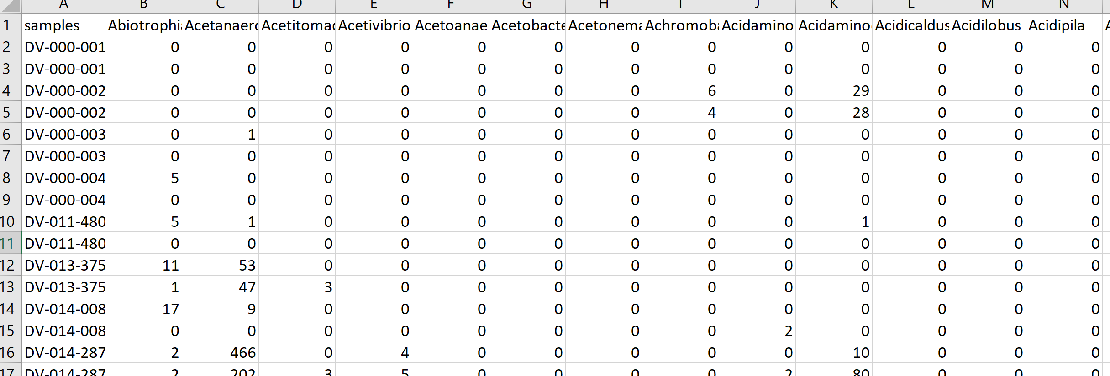
Roshonda Barner Jones
University of Southern California
Biopsies from 226 case and 309 control obtained via
colonoscopy
Temitope Keku
UNC Chapel Hill
Microbial DNA extracted – PCR targeting the 16S rRNA gene
Sequences generated via Illumina sequencing.
Classified into a counts table
Image: https://www.merckmanuals.com/-/media/manual/professional/images/diverticulosis_high.jpg?la=en&thn=0&mw=350
An Aberrant Microbiota is not Strongly Associated with Incidental Colonic Diverticulosis Roshonda B. Jones, Anthony A. Fodor, Anne F. Peery, Matthew C. B. Tsilimigras, Kathryn Winglee, Amber McCoy,Michael Sioda ,Robert S. Sandler, Temitope O. Keku. Scientific Reports. 2018.
Notes:
A colonic diverticulum is a saclike pouch of colonic mucosa and submucosa that protrudes through the muscular layer of the colon

Slide 11
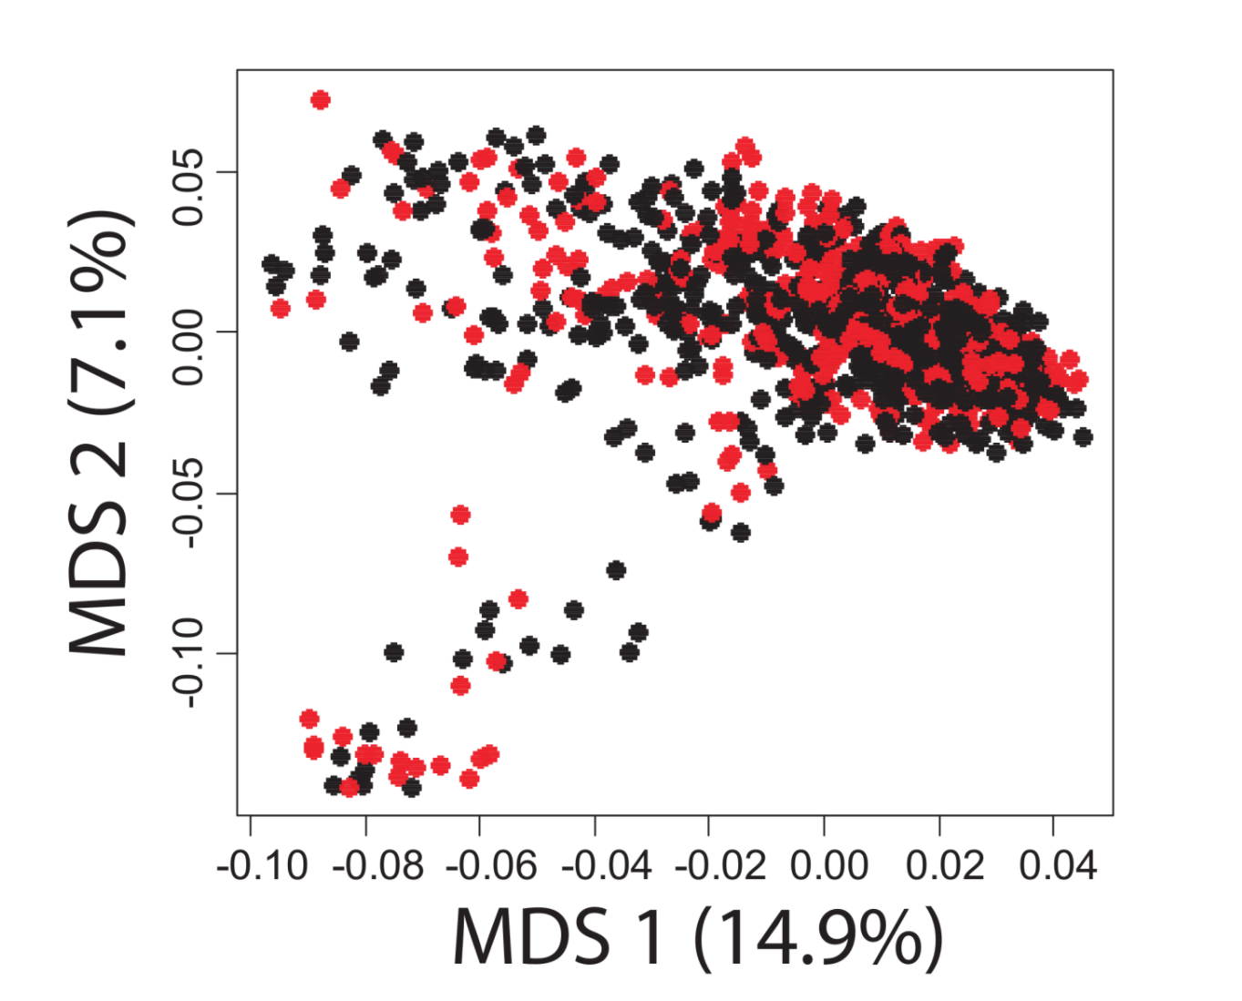
A case-control study in Colonic Diverticulosis with a small effect size
Roshonda Barner Jones
University of Southern California
Temitope Keku
UNC Chapel Hill
An Aberrant Microbiota is not Strongly Associated with Incidental Colonic Diverticulosis Roshonda B. Jones, Anthony A. Fodor, Anne F. Peery, Matthew C. B. Tsilimigras, Kathryn Winglee, Amber McCoy,Michael Sioda ,Robert S. Sandler, Temitope O. Keku. Scientific Reports. 2018.

Slide 12
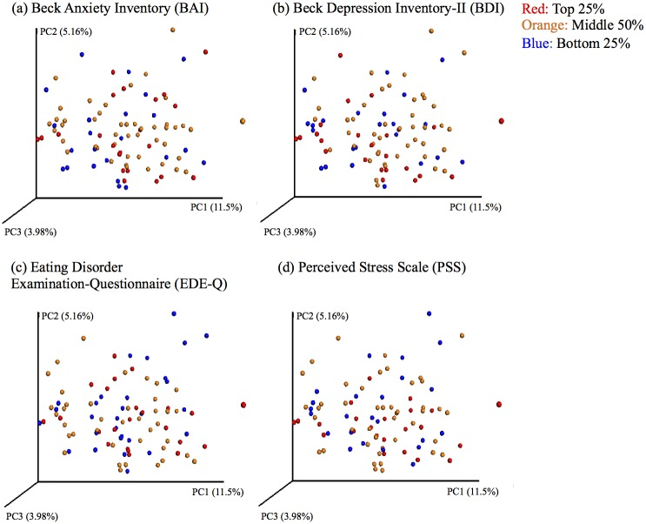

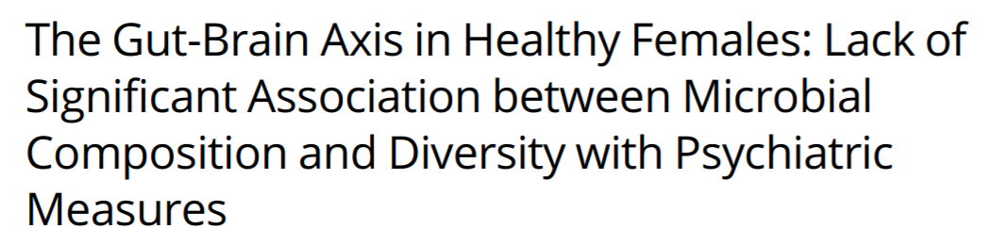
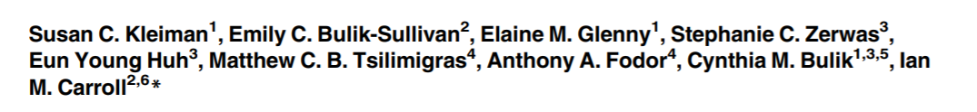
Ian Carroll
UNC Chapel Hill

Slide 13

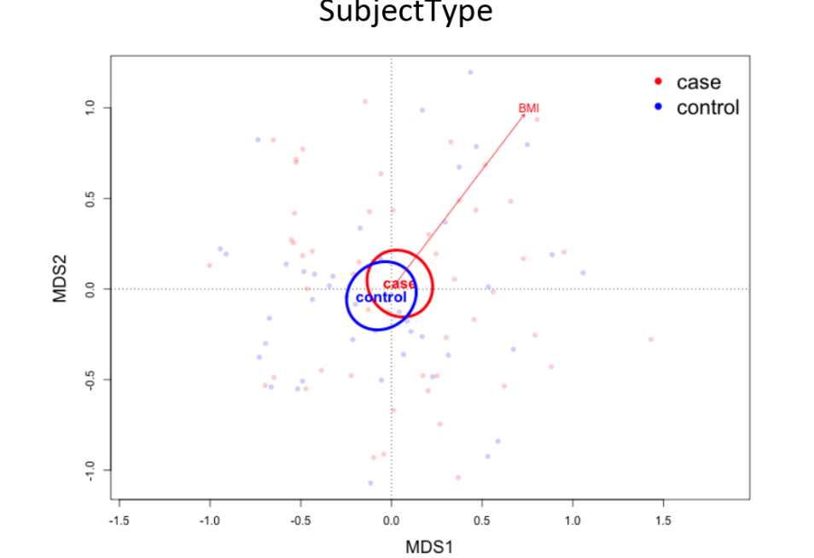

Metabolic Osteoarthritis
Richard F. Loeser UNC
Liubov Arbeeva UNC

Slide 14
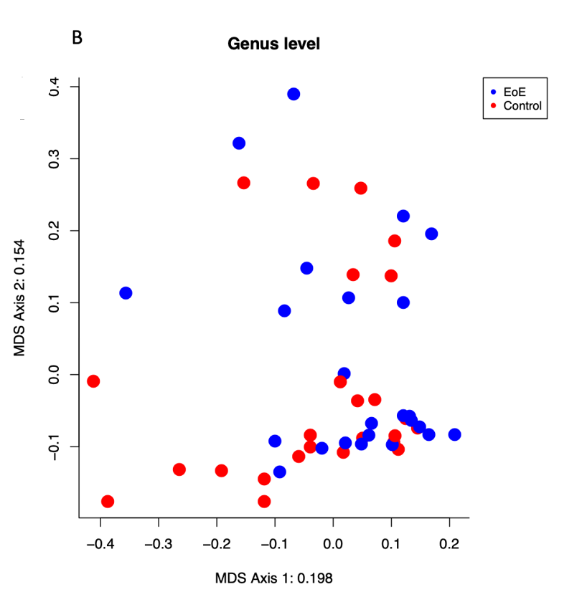

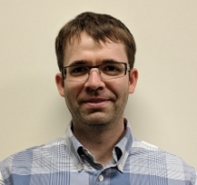
Eosinophilic esophagitis (EoE)
Evan Dellon, UNC
James Johnson, UNCC
Lack of association of the esophageal microbiome in adults with eosinophilic esophagitis compared with non-EoE controls. In preparation

Slide 15
Effect Sizes in Association Studies are Reliably Small
There is strong individual variation in the microbiome

Slide 16
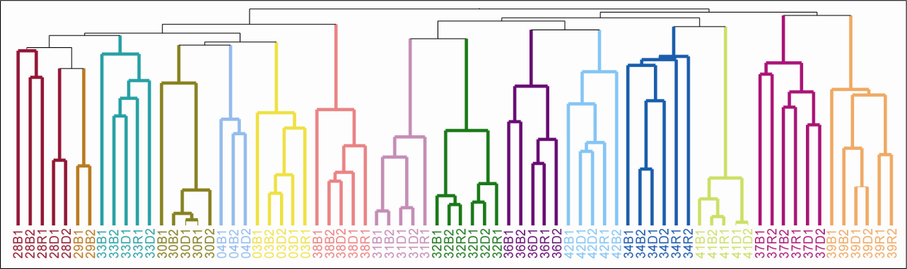
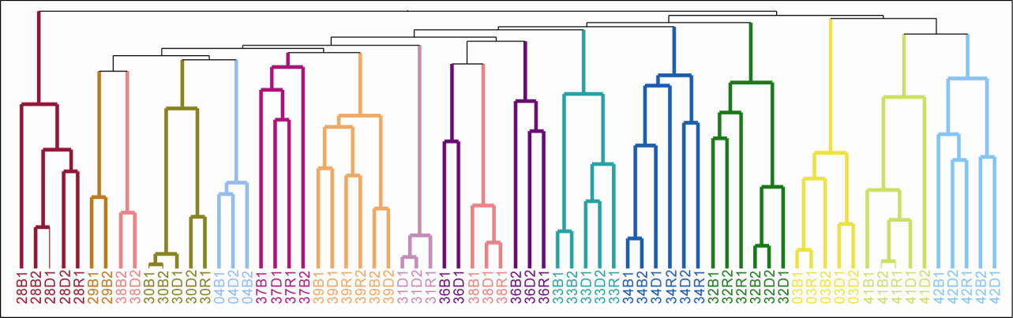


Human gut microbial communities are distinctly individual
Individuality persists despite common diet and conditions
OTUs at 97%
ARISA
Melanie Spencer
Atrium Health
Steve Zeisel UNC
Melanie D. Spencer, Timothy J. Hamp, Robert W. Reid, Leslie M. Fischer, Steven H. Zeisel, Anthony A. Fodor. Gastroenterology. 2011

Slide 17
Effect Sizes in Association Studies are Reliably Small
There is strong individual variation in the microbiome
Sample sizes need to be very large

Slide 18

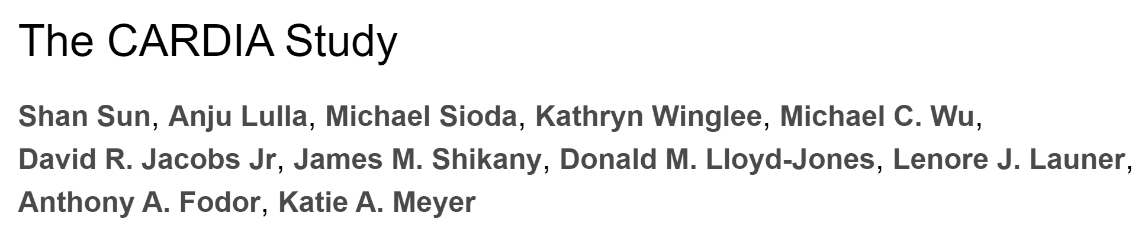
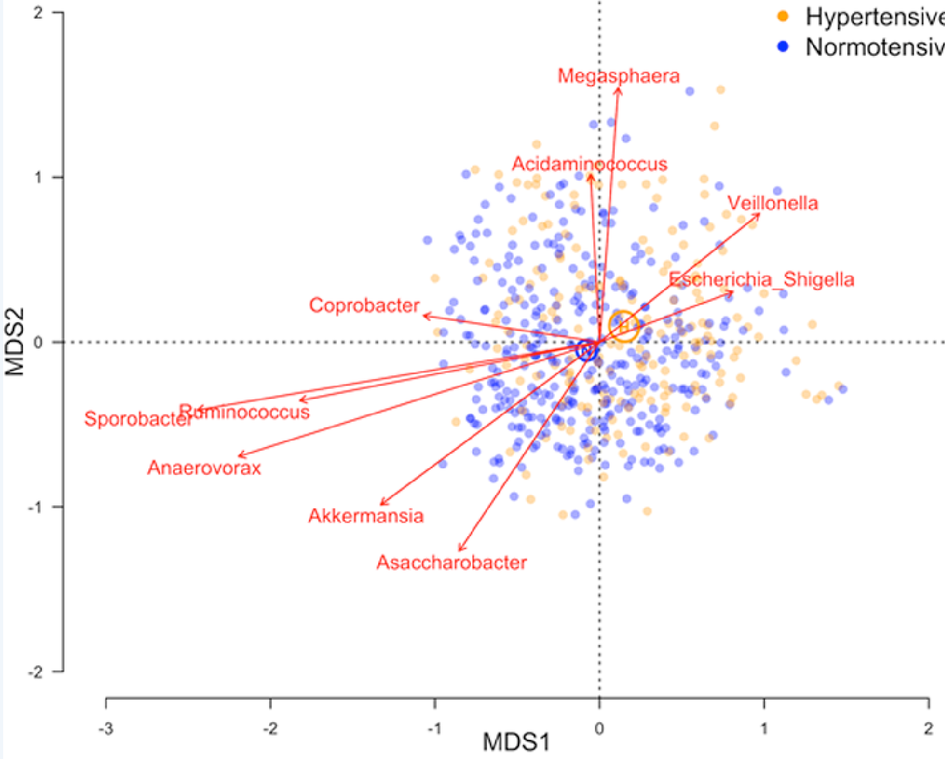

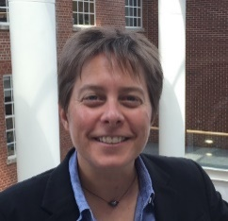
Shan Sun
UNC Charlotte
Katie Meyer UNC
N=529

Slide 19
Effect Sizes in Association Studies are Reliably Small
There is strong individual variation in the microbiome
Sample sizes need to be very large
Inference can survive technical differences

Slide 20
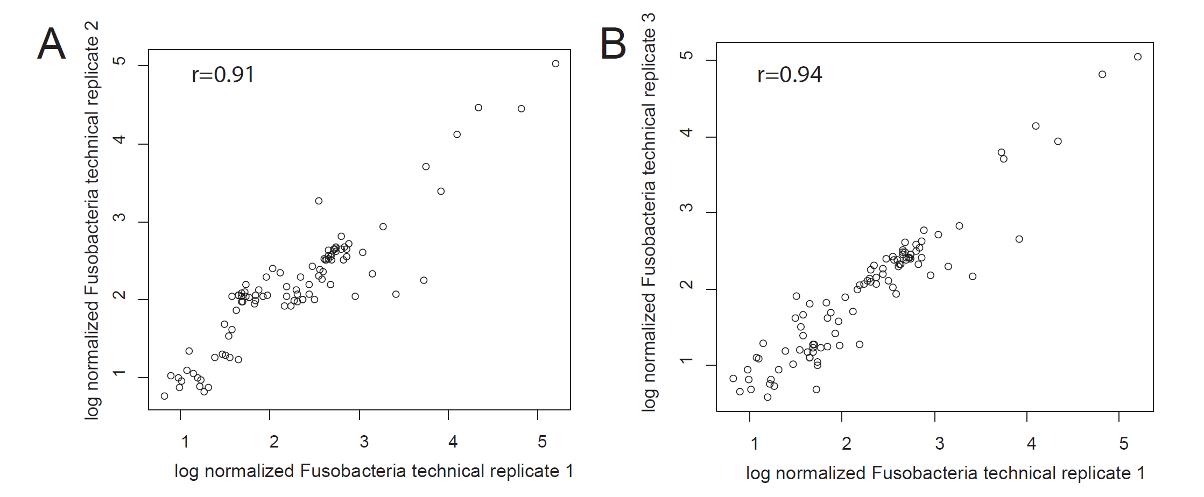
Within a pipeline, PCR and extraction steps can be highly replicable
Rifaximin Treatment is Associated With Small, Transient Decreases in Multiple Taxa in the Human Gut Microbial Community. Fodor et al. In revision, Gut Microbes

Slide 21
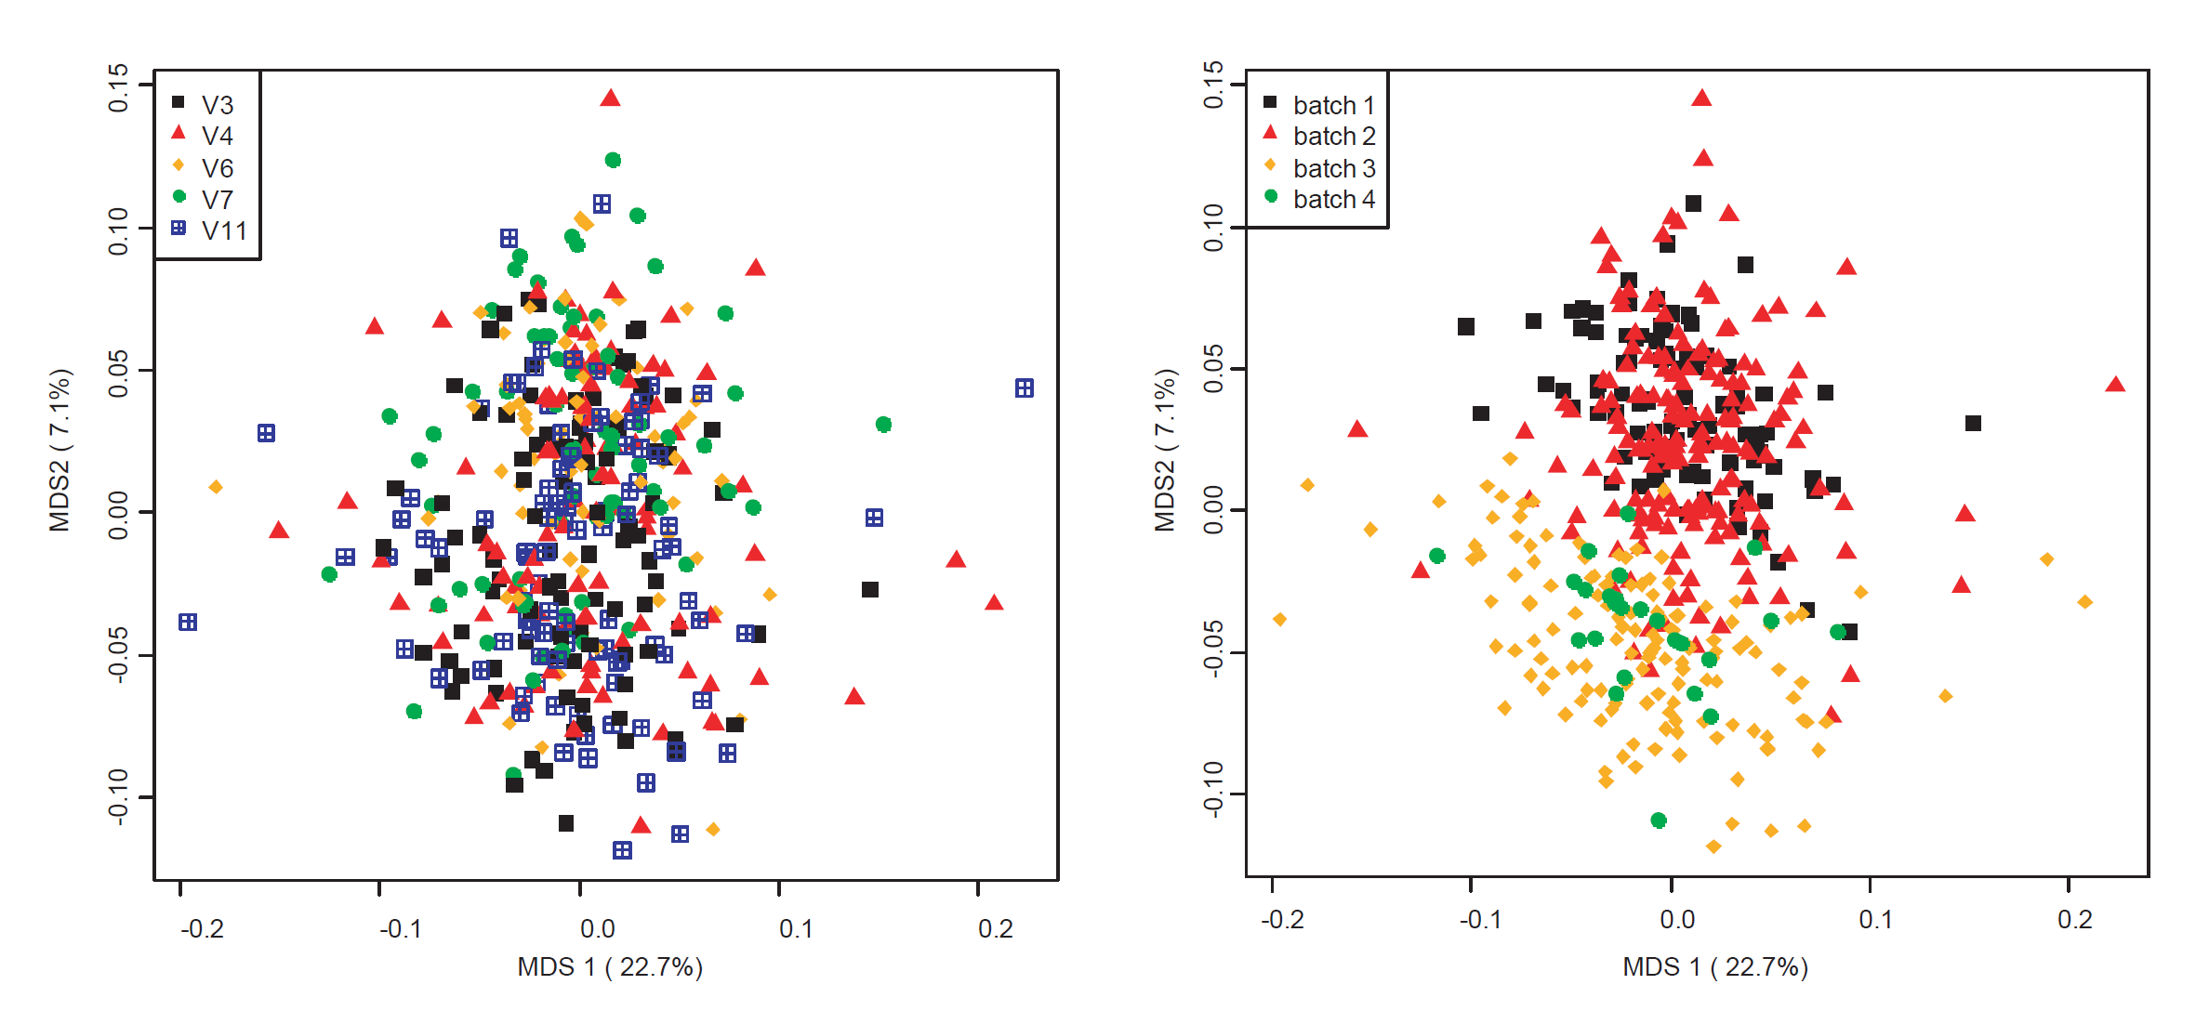
Batch effects can be pronounced
Batches are “islands”
Rifaximin Treatment is Associated With Small, Transient Decreases in Multiple Taxa in the Human Gut Microbial Community. Fodor et al. In revision, Gut Microbes

Slide 22
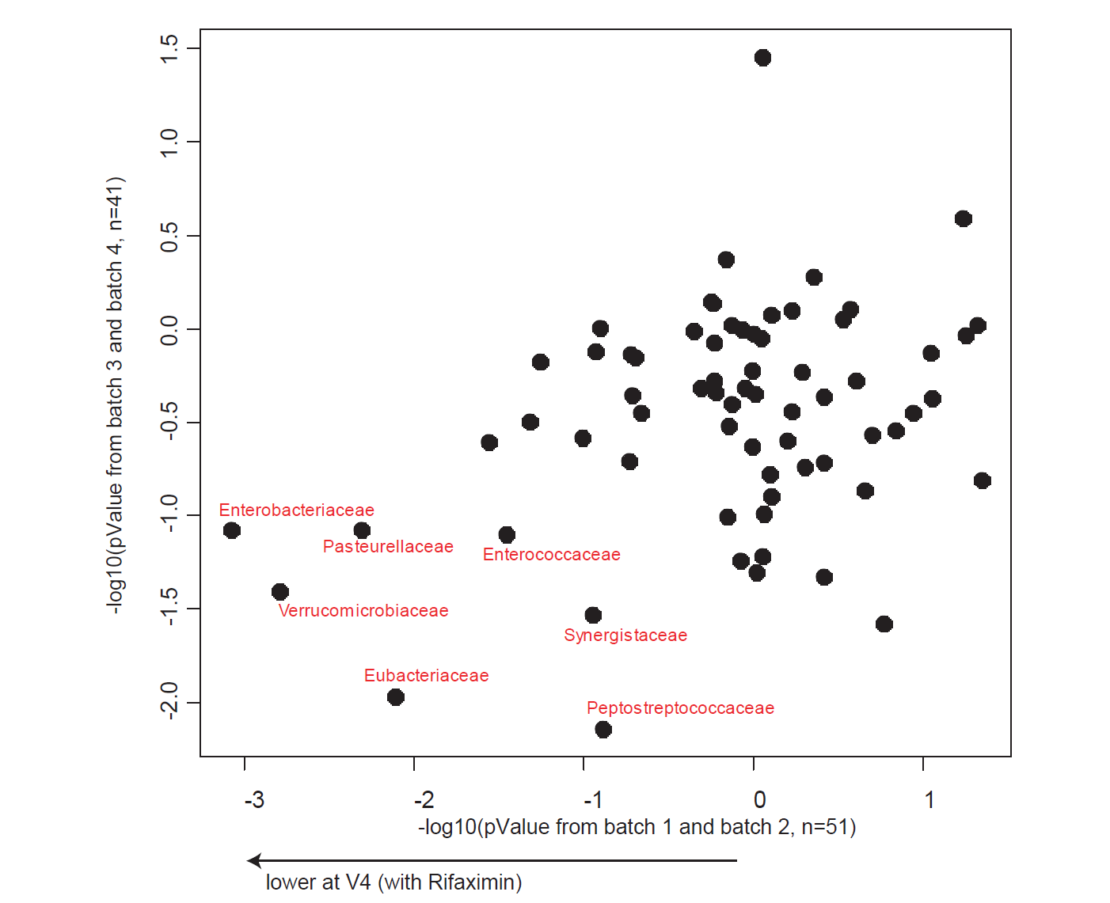
Inference can (hopefully) survive across batch effects

Slide 23
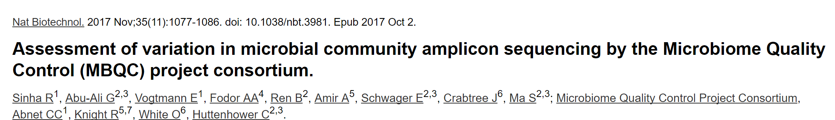


Lab to lab variation in protocols (especially microbial DNA extraction) can have
a profound impact…
Rashmi Sinha
NIH
Curtis Huttenower
Harvard

Slide 24
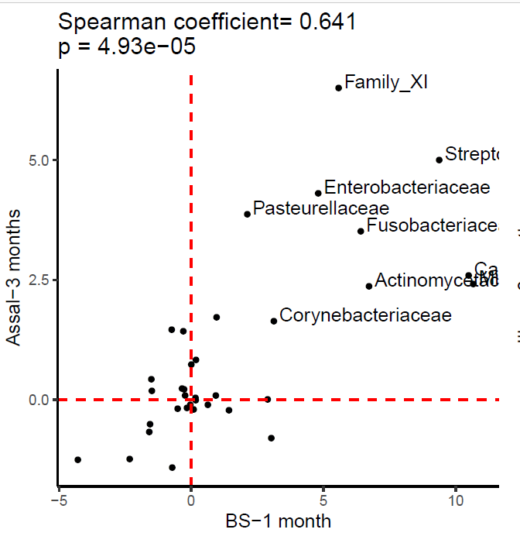

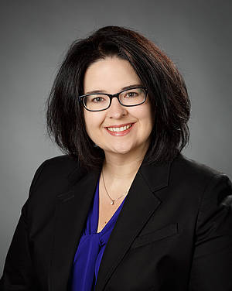

But it is possible to get reproducible results across studies from different labs
-log10(pValue)
Farnaz Fouladi
UNC Charlotte
Kristine Steffen
NDSU
Leslie Heinberg
Cleveland Clinic
-log10(pValue)

Slide 25
Effect Sizes in Association Studies are Reliably Small
There is strong individual variation in the microbiome
The microbiome is an environmental variable
and important interactions with the host are
not globally conserved

Slide 26
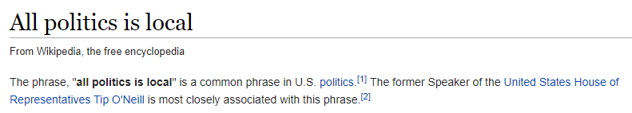
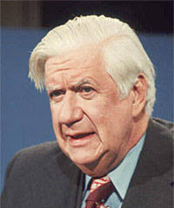

Slide 27

The microbiome is an environmental variable that is sensitive to local conditions
Penny Gordon-
Larsen
UNC Chapel Hill
Shan Sun
UNC Charlotte
(in preparation)

Slide 28
The microbiome is an environmental variable that is sensitive to local conditions
2,164 subjects from the China Health and Nutrition Survey
(http://www.cpc.unc.edu/projects/china )
Penny Gordon-
Larsen
UNC Chapel Hill
Shan Sun
UNC Charlotte
(in preparation)

Slide 29
The microbiome is an environmental variable that is sensitive to local conditions
2,164 subjects from the China Health and Nutrition Survey
(http://www.cpc.unc.edu/projects/china )
Fecal samples collected; 16S rRNA sequencing
Penny Gordon-
Larsen
UNC Chapel Hill
Shan Sun
UNC Charlotte
(in preparation)

Slide 30
The microbiome is an environmental variable that is sensitive to local conditions
2,164 subjects from the China Health and Nutrition Survey
(http://www.cpc.unc.edu/projects/china )
Fecal samples collected; 16S rRNA sequencing
Classification and generation of count table
Penny Gordon-
Larsen
UNC Chapel Hill
Shan Sun
UNC Charlotte
(in preparation)

Slide 31
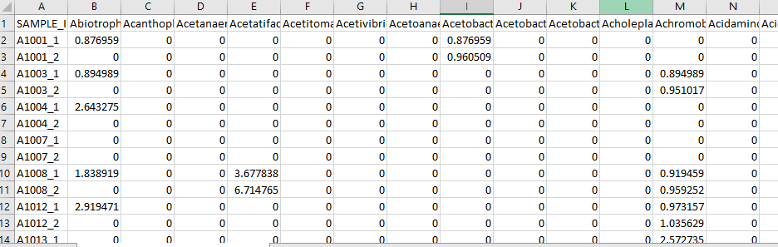
The microbiome is an environmental variable that is sensitive to local conditions
2,164 subjects from the China Health and Nutrition Survey
(http://www.cpc.unc.edu/projects/china )
Fecal samples collected; 16S rRNA sequencing
Classification and generation of count table
Penny Gordon-
Larsen
UNC Chapel Hill
Shan Sun
UNC Charlotte
(in preparation)

Slide 32
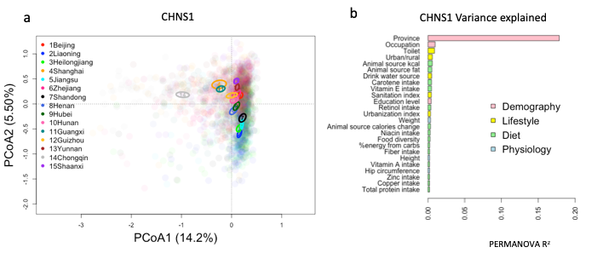
The microbiome is an environmental variable that is sensitive to local conditions
CHINA
Penny Gordon-
Larsen
UNC Chapel Hill
Shan Sun
UNC Charlotte
(in preparation)

Slide 33
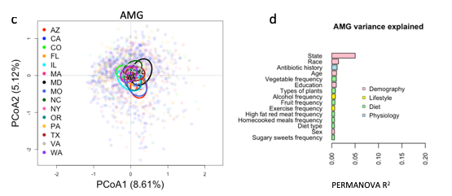
The microbiome is an environmental variable that is sensitive to local conditions
CHINA
Penny Gordon-
Larsen
UNC Chapel Hill
US
(American Gut)
Shan Sun
UNC Charlotte
(in preparation)

Slide 34
The microbiome is an environmental variable that is sensitive to local conditions
2,164 subjects from the China Health and Nutrition Survey
(http://www.cpc.unc.edu/projects/china )
Fecal samples collected; 16S rRNA sequencing
Classification and generation of count table
Penny Gordon-
Larsen
UNC Chapel Hill
Use the microbiome to predict subject phenotype
Shan Sun
UNC Charlotte
(in preparation)

Slide 35
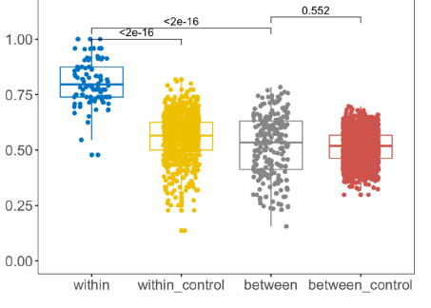
Machine learning models can be trained within but not across provinces
True Positive Rate
Penny Gordon-
Larsen
UNC Chapel Hill
Urban/Rural classification
Shan Sun
UNC Charlotte

Slide 36

unexplained variance can always be attributable to “dark matter”
https://home.cern/science/physics/dark-matter

Slide 37
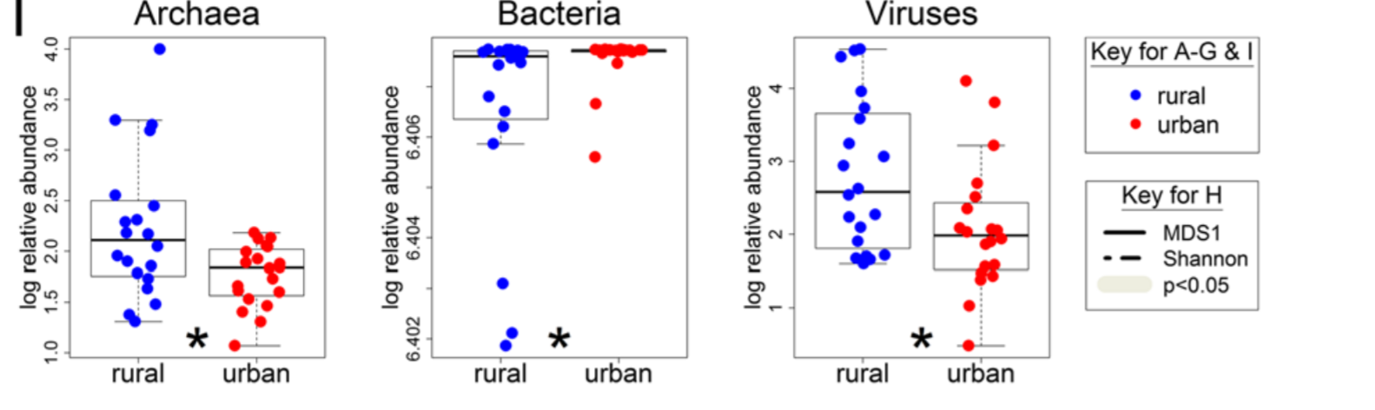
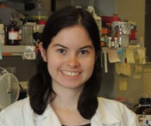
Metagenomic variability beyond bacteria is largely un-explored
There is no shortage of biological “dark matter”
Kathryn Winglee
CDC
Atlanta
Penny Gordon-
Larsen
UNC Chapel Hill
Recent urbanization in China is correlated with a Westernized microbiome encoding increased virulence
and antibiotic resistance genes Winglee et. al - Microbiome 2017

Slide 38
How do we pursue mechanism despite small effect sizes?
Go Big (increase sample size in humans)

Slide 39
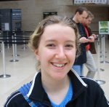

Every analysis will need to be a meta-analysis
Ivory Blakely–
UNC Charlotte
Michael Sioda
UNC Charlotte

Slide 40
Experimental design
Visualization and statistical analysis
Sample Size (# of cages not just # of mice)
Properly consented cohorts
Capture of confounding variables
Sufficient variation across space and time
Negative and Positive controls
Which diversity metrics?
Log-transform data?
Parametric or non-parametric tests?
Simple linear models?
Mixed models?
Zero-inflated models?
Negative-binomial based models?
Correction for multiple hypothesis testing?
Remove rare taxa?
Track sequencing depth as a confounder.
Track potential biological confounders
(e.g. cage in mouse experiments; drugs in
human surveys)
Supervised classification to build predictive
models? Cross-fold validation?
Random Forest classifiers?
Reproducibility across cohorts and datasets
generated by different labs?
Ordination?
Unifrac (weighted or un-weighted).
or PcOA? With what distance metric
(Bray-Curtis?)
Multi-page, multi-factorial visualizations?
DNA extraction
Which extraction kit/protocol?
Which sequencing platform?
Whole genome or 16S? If 16S, which primers?
sequencing
Merged paired ends? With what parameters?
Qual score filter? With what parameters?
Filter against database of known sequences? With what parameters?
Chimera check? Which algorithm? With what parameters?
Sufficient sequencing depth? Remove unique sequences?
Classification/clustering
Reference database or denovo OTUs? Or something in between?
Which algorithm (RDP, kraken, greengenes, uparse)?
What database? With what parameters?
Are the sequences microbial? From the expected tissue?
Are they just kit microbes?
Normalization
Simple proportions? Rarefication (with what depth?
single rarefication vs. average).
Balance trees? Ratio space? Geometric Mean based normalization?

Slide 41
How do we pursue mechanism despite small effect sizes?
Go Big (increase sample size in humans)
Go Deep (study mechanism in animals)

Slide 42
What changes in a mouse transfer experiment?
Microbial Community from Feces to Slurry
Microbial Community from Slurry
to Mice
Healthy Control
n=4
n=1/donor
N=4
n=3-6/donor
N=21 slurries
n=1-3/slurry
n=12-14/donor
N=50 mice
Ian Carroll
UNC Chapel Hill
Anorexia before Treatment
n=4
n=1/donor
N=4
n=1-3/slurry
n=12-14 /donor
N=50 mice
n=5-7/donor
N=24 slurries
Anorexia after Treatment
n=4
Farnaz Fouladi
UNC Charlotte
n=1/donor
N=3
n=5-6/donor
N=23 slurries
n=1-4/slurry
n= 12-16 /donor
N=52 mice
Notes:
Fecal sample :1 sequencing of one donor from Anorexia after treatment failed (40T2)
In meta data we have 69 slurries……One slurry (HC 40) failed sequencing. 5 slurries of 40T2 was not included in fecal-slurry analysis because we don’t not have its fecal microbiota.
For a few number of mice we do not have the sequencing data of the slurries they receive so they are not included in the slurry-mice correlation analysis.

Slide 43
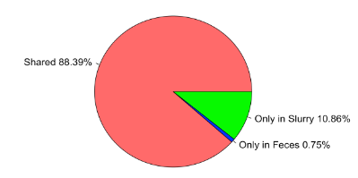
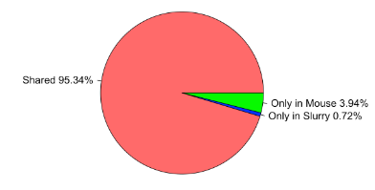
What changes in a mouse transfer experiment?
fecal to slurry
slurry to mouse
Shared 89%
Shared 95%
Ian Carroll
UNC Chapel Hill
Farnaz Fouladi
UNC Charlotte

Slide 44
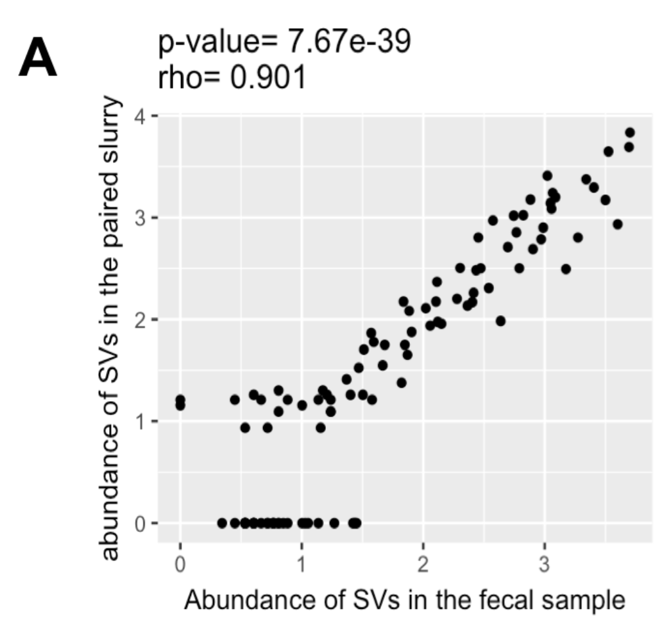
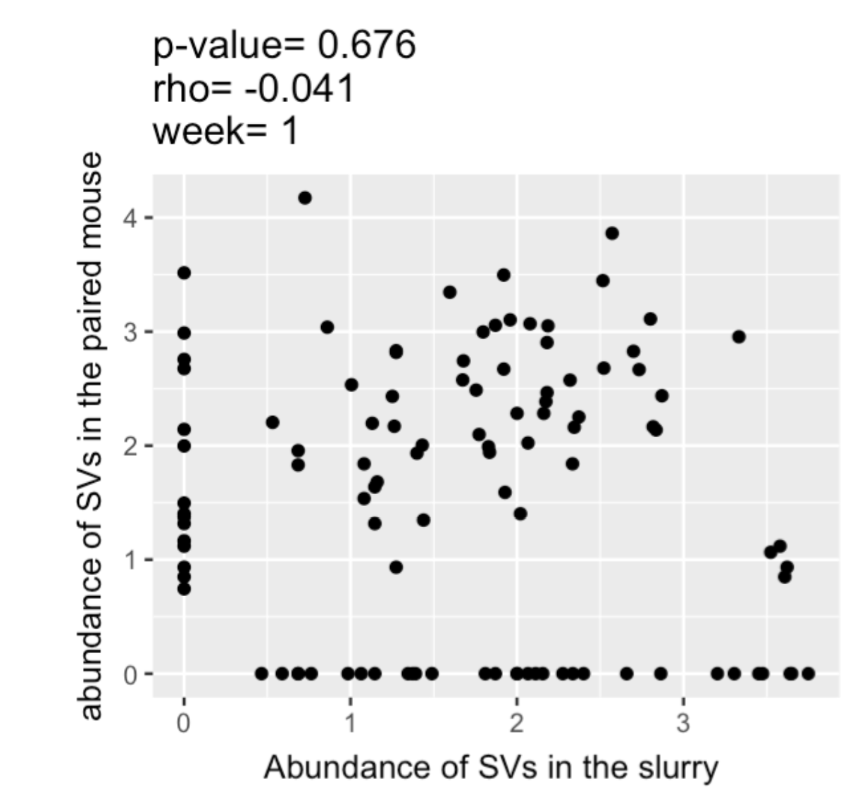
What changes in a mouse transfer experiment?
fecal to slurry
slurry to mouse
Shared 89%
Shared 95%
Ian Carroll
UNC Chapel Hill
Farnaz Fouladi
UNC Charlotte

Slide 45
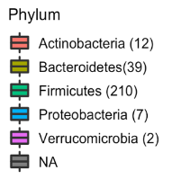
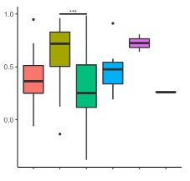
Transfer efficiency varies by different taxa
RHO
Ian Carroll
UNC Chapel Hill
Farnaz Fouladi
UNC Charlotte

Slide 46

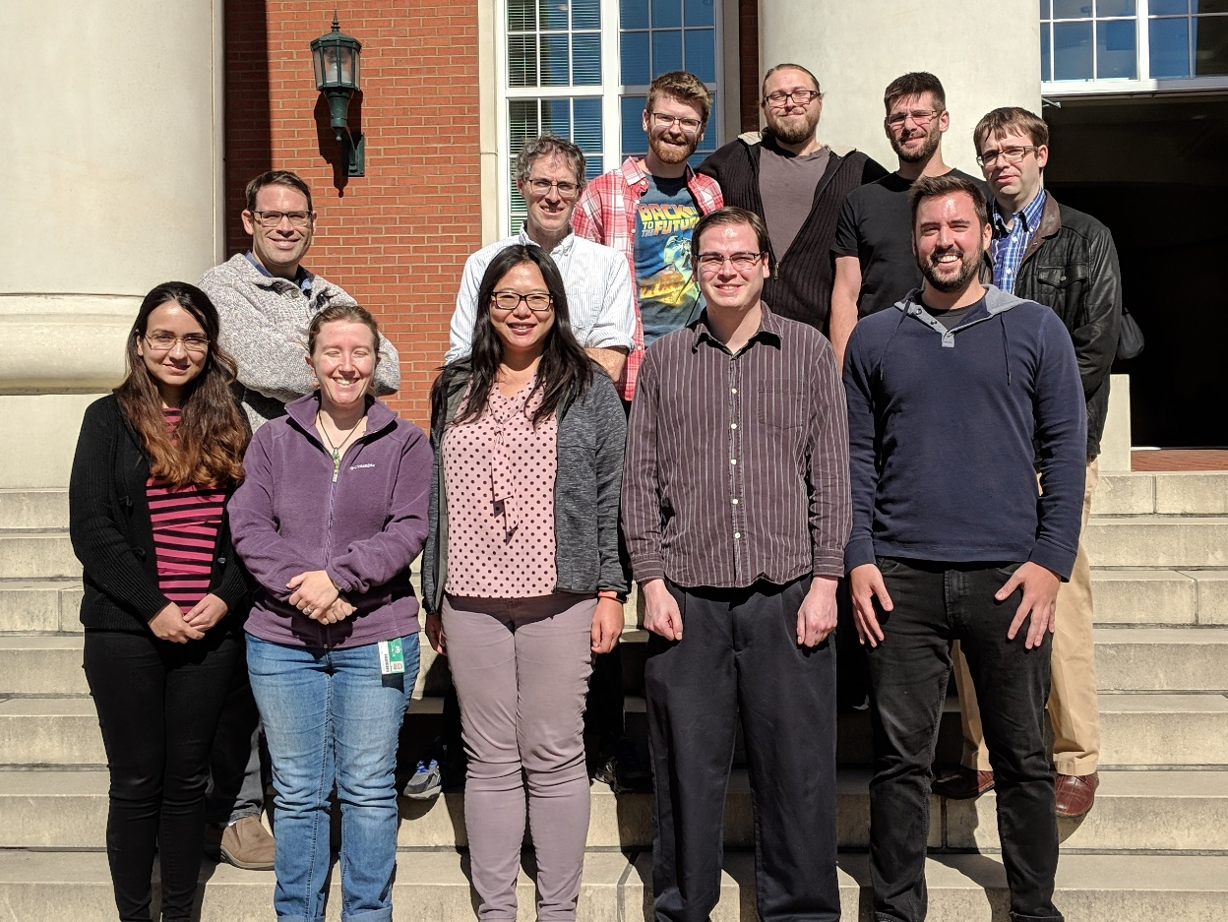

Slide 47


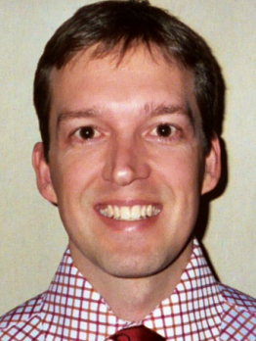

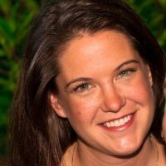


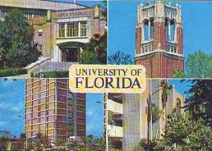



Acknowledgements
UNC-Chapel Hill
Janelle Arthur
Ian Carroll
Annie Green Howard
Marcus Muhlbauer
Penny Gordon-Larsen
Jonathan Hansen
Temitope Keku
UNC-Charlotte
Roshonda Barner
Matthew Brown
Farnaz Fouladi
Ra’ad Gharaibeh
Cynthia Gibas
Jon McCafferty
Shan Sun
Michael Sioda
Kathryn Winglee
Matthew Brown
UF- Gainesville
Christian Jobin
USC Vanderbilt University
Tanya L Alderete Martha J. Shrubsole
Michael Goran
Emily Noble
Scott Kanoski
Kathryn Winglee
Annie Green Howard
Penny Gordon-Larsen
Raad Gharaibeh
Jon McCafferty
Marcus Muhlbauer
Janelle Arthur
Christian Jobin

